Slide 1


Aviation
Technology
Hackathon​
ABDUL BASIT SYED ​
AHSAN KAMAL​
KARL MENDONCA​
SATYA KUMAR ITEKELA​
YANSONG LI

Slide 2
Challenges
Passenger Experience
There is no contactless virtual assistance at the airport
No way to receive airport announcements on your device, translate and listen them in different languages
Revenue generation
Not leveraging advertisement or chatbot technology as a revenue source

Slide 3
Solutions
Passenger Experience
We created a web application prototype which allows passengers to receive airport announcements as notifications and also allows them to translate and listen to them in different languages of their choice
Integrated chatbot (contactless airport virtual assistance)
Revenue generation
Advertising space on web application
Chatbot redirection to the websites where people can complete their order

Slide 4
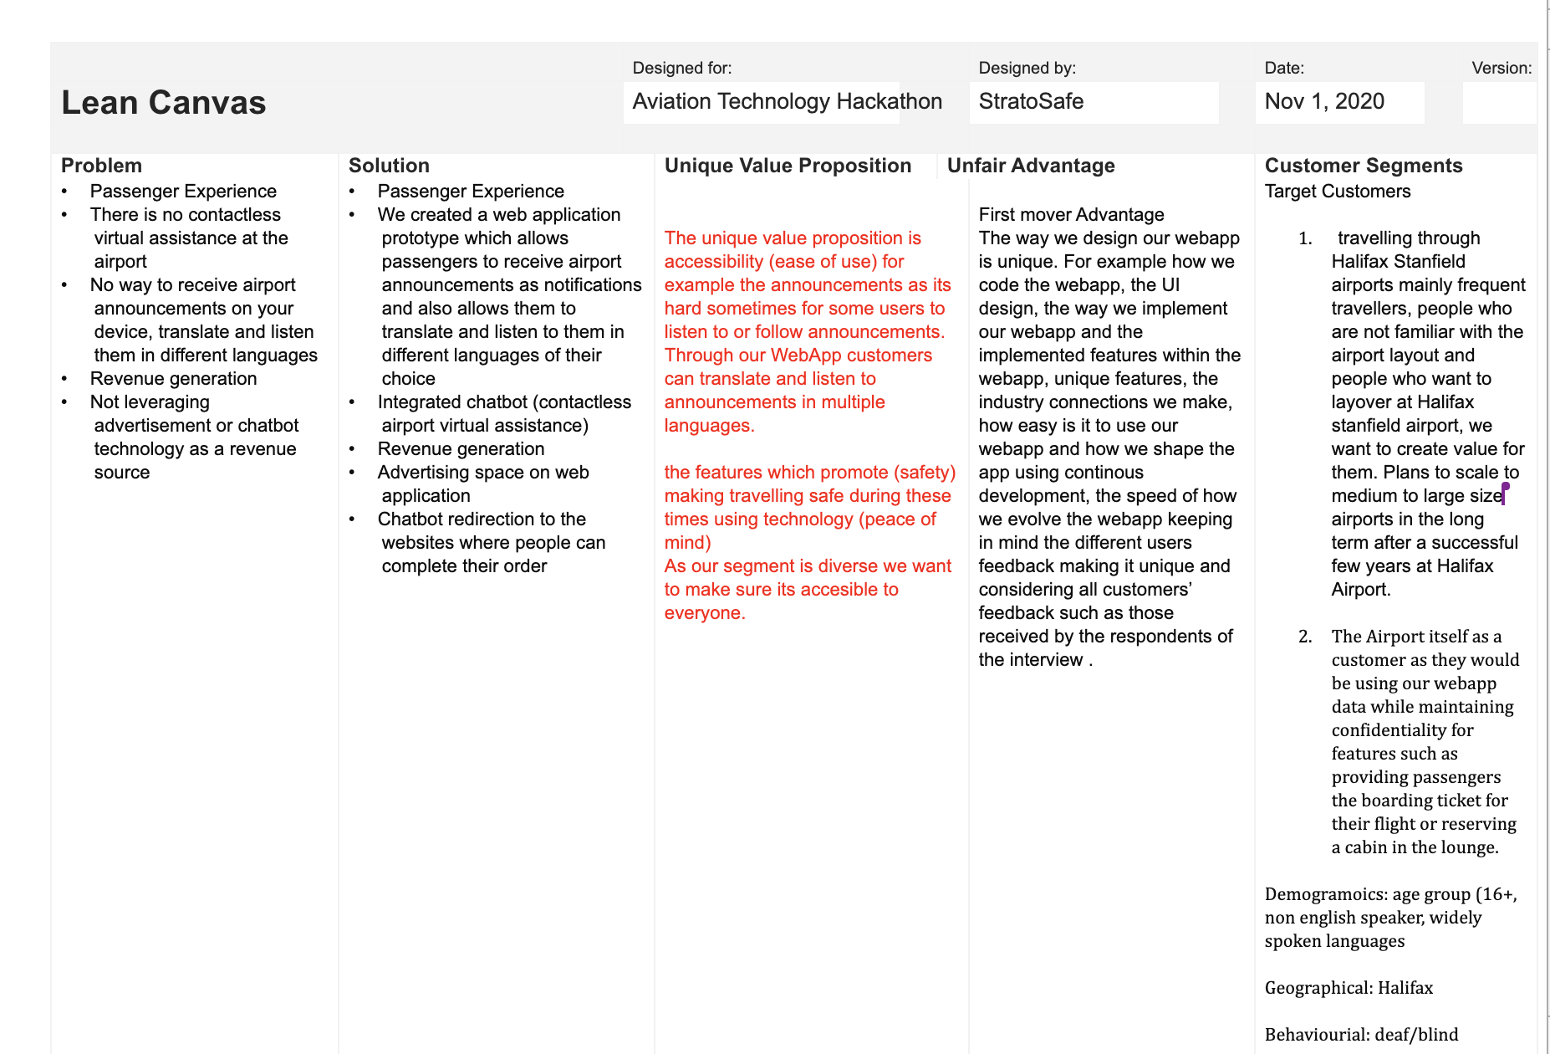
Business Model Lean Canvas

Slide 5
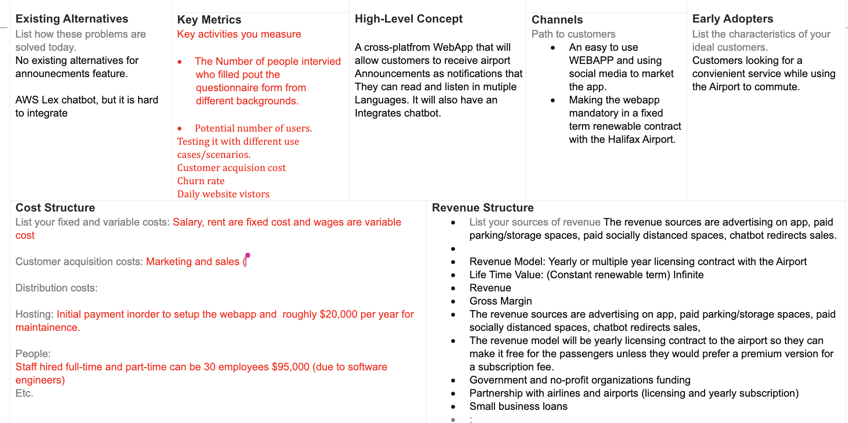
Business Model Lean Canvas

Slide 6
Our Team
Abdul Basit Syed
Web development (HTML, CSS, JS), leadership, innovation, scrum, design thinking
Ahsan Kamal
Full stack web developer (React Js, AWS, Python, Java), Database design
Karl Mendonca
Entrepreneurship, brainstorming, innovation
Yansong Li
Back-end developer (Java, C), Database
Satya Kumar Itekela
Front-end developer

Slide 7
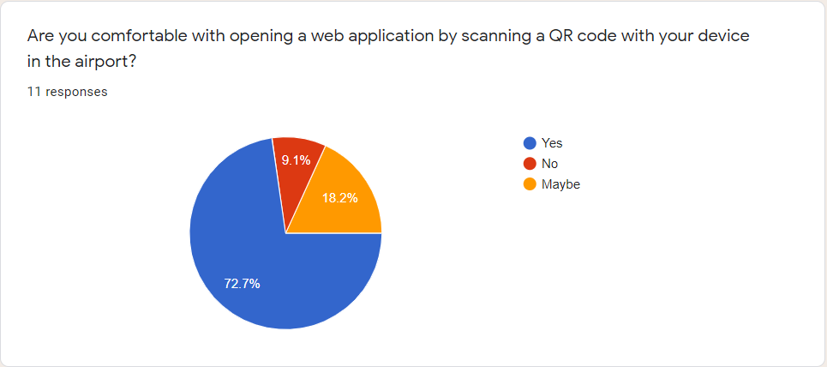
Data Analytics

Slide 8
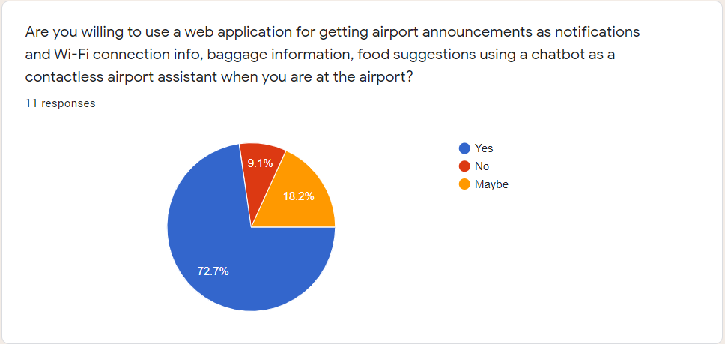
Data Analytics

Slide 9
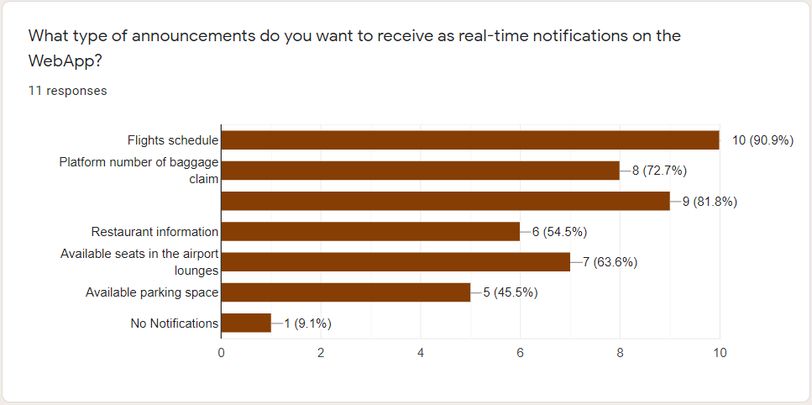
Data Analytics

Slide 10
Impact
Improves passenger experience by making airport announcements more accessible
Improves passengers convenience and safety through chatbot (contactless airport virtual assistance)
Introducing revenue streams for the airport through WebApp advertisements and chatbot redirections to sellers website

Slide 11
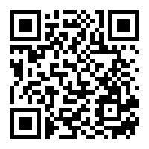
Prototype
Features
Ability to access and use the WebApp by scanning the QR code
Ability to receive airport announcements in the form of notifications; translate and listen announcements in multiple languages
Ability for the airport authorities to mange the live announcements which are customizable and can be scheduled.
Chatbot (under development) – can be used to find airport services, check flight status and schedule, find baggage belt number, see latest COVID-19 rules, search and purchase items from stores, café, and restaurants at the airports, search and read ebooks, and airport navigation help.
Advertising space in the WebApp which can be a source of revenue
Easy to use

Slide 12
Future Plan
Making the chatbot fully functional using AI and NLP
Adding announcement panel for the airport admin and staff
Supporting more languages for the announcements
Scaling to support multiple airports
Adding a functionality in the chatbot to order from restaurants, café, and stores at the airport with less human interaction.

Slide 13
Ask
Integration help from the airport so our WebApp can be adopted into their system
Help from the airport to advertise our webapp at strategic location throughout the airport
Deployment and hosting cost to AWS or any other cloud platform
Usage cost of AWS cloud services such as speech-to-text
Mentorship and planning
Aviation industry connections

Slide 14
THANKS! Any Questions?

